Slide 1
Fraud Detection
Accredian Assignment
Name:Ankita Yadav
Btech in Computer Engineering

Slide 2
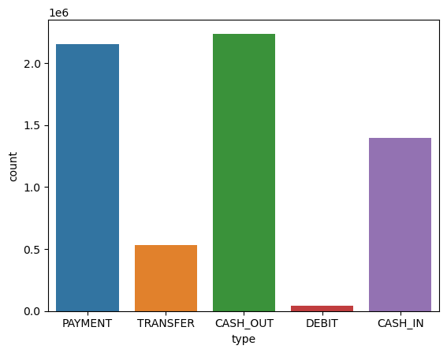
Figure 1:

Slide 3
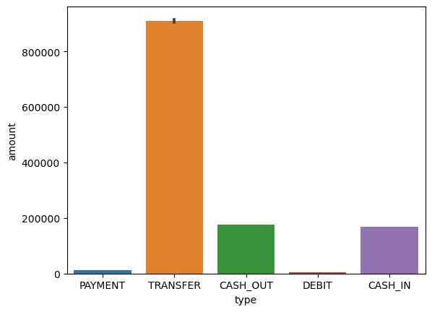
Figure 2:

Slide 4
Conclusion From fig 1 and fig 2
From the previous figure it is clear that rate cash out and transfer is more than other columns.
Other show less rate and count than the two

Slide 5
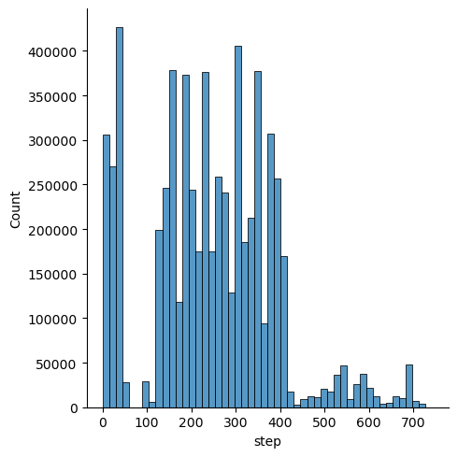
Distribution plot:

Slide 6
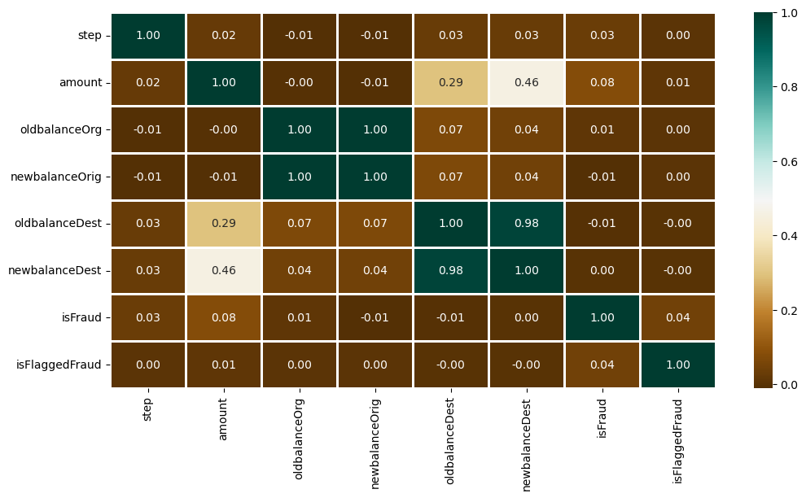
Heat map for showing the correlation:

Slide 7
Algorithms used:
Logistic regression:
Training Accuracy : 0.8873943416757113
Validation Accuracy : 0.884991555251351
XGBClassifier:
Training Accuracy : 0.9999774189140321
Validation Accuracy : 0.999212631773824

